Slide 1
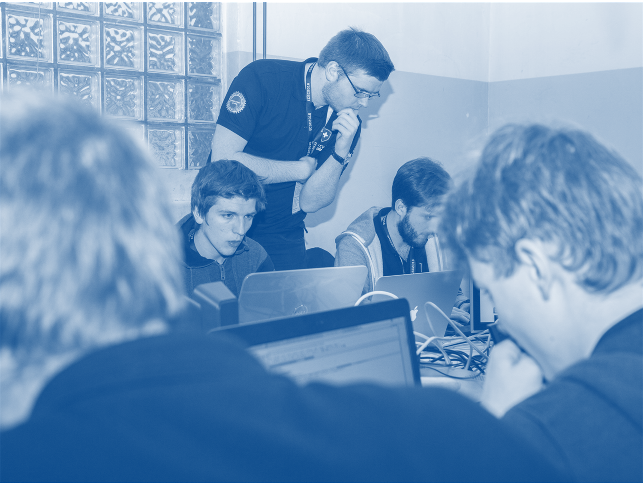

Awareness

Slide 2
Your Activities in the Cyber Space
Summary:
Notes:
Answers might be:
Watching videos / TV
Browsing
Shopping
Chatting / Social Media
WhatsApp
Reading and writing e-mails
e-banking
…
Most of these activities require an ACCOUNT to perform them.
Now that you thought about your activities in the cyber space, let’s think about threats related to them.

Slide 3
What are the Threats in the Cyber Space?
Summary:
Notes:
What threats are the participants aware of? They should relate to the activities mentioned before.
Stolen passwords / account information (phishing, social engineering,…)
Cyberbullying
Malware on ones PC (Ransomware, Spyware, …)
(Credit-card) Fraud
Provider exposes my data to the world (hacks)
Availability - Denial of service attacks
Destruction of Software/Hardware
…
You identified several threats. Unfortunately, we can’t look at them all. We’ll focus on those threats that we consider most relevant because they are quite prominent today:
Hijacking of user accounts (DropBox, Sony Playstation, Gmail, Microsoft, Apple,…)
Infections with malware

Slide 4

Hijacking User Accounts

Slide 5
User Accounts - Survey
No representative study on this subject – Numbers from different studies range from around 10 to 100 accounts/passwords per person
Number of Accounts
0
1-4
5-9
10-20
more than 20
Accounts at:
Notes:
Let’s see whether hijacking of accounts is a valid and valuable attack target.
Go through the number of accounts options and let the audience raise hands for the number of online accounts they own (DropBox, WhatsApp, E-Mail, Facebook, Playstation, Google, Microsoft,…) and note down the numbers.
Ask the participants to name companies and/or services where they have accounts. Note down the names of the companies/services.
This is the attack surface for hijacking accounts of the audience.
Usually, this should look quite nice (several accounts per person, a wide variety of services used).
As a hacker, I like a big attack surface because this offers a lot of options for an attack! So a first step to make the life of a hacker more difficult is not to tell him what accounts you have where… ☺
The next step is now to make use of this knowledge to start an attack. For the attack, we have to select an attack vector.

Slide 6
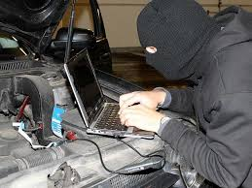
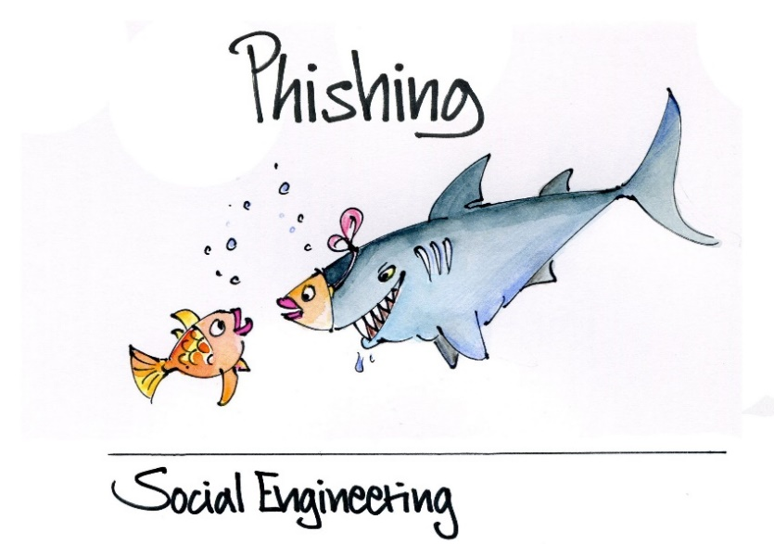

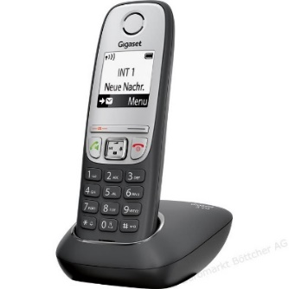

Attack Vectors
Without your “help”:
Hackers attack the server-side
They break into the systems of the companies involved in offering/hosting the service
With your “help”:
Hackers attack the client-side:
Hackers attack you and/or your hardware to steal your account data
Notes:
To hack into you user account or to steal user account data, a hacker has the above two main attack vectors:
The «Server»: The infrastructure/provider. This means an attacker does not need to involve you or your software/hardware in any way. Nevertheless, as you will see, there is still something you can do to limit the impact of a successful attack as a user. The benefit of this attack vector is that a hacker can potentially obtain information about all user accounts, not just the account of the victim.
The Client: You, your Software and Hardware. Here, the attacker identified you as the weakes link and tries to obtain your details by:
Installing malware when you browse to a malicious website (e.g., when searching for «free» software) or visit a benign websites that has been hacked. To install the malware, hackers exploit vulnerabilities in browsers. For example, in 2016, 20 minutes has been used to distribute malware several times: http://www.swissinfo.ch/eng/20-minute-attack_government-shuts-down-trojan-infected-website/42074870
tricking you into doing something you shouldn’t do (=>social engineering).
Examples:
Phone call from «Microsoft» telling you they have found a problem on your computer and they help you to fix it. You’ll have to install a piece of legitimate software at some point that will give them access to your machine. http://www.wired.co.uk/article/malwarebytes
You get an e-mail from a colleague telling you that you should download this cool new app. Unfortunately, the app has additional «features» you won’t like… https://www.heise.de/security/artikel/Analysiert-Werbekeule-statt-Glitzersteine-Android-Malware-CallJam-seziert-3340267.html (in German)
There exist many different ways on both ends how an attacker can reach his or her goal.
We’ll have a look at some of the options and what you can do to limit what a hacker can do as a user.

Slide 7
Hijacking User Accounts
Attacking the Server-Side

Slide 8
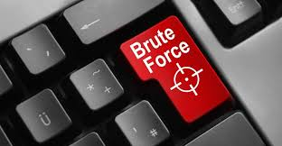
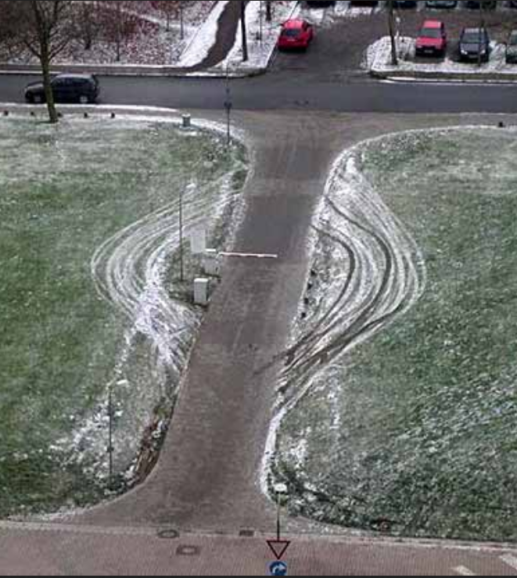
Basic Attack Strategies
OR
Notes:
Basic attack strategies are:
Exploiting a vulnerability in the system and/or circumventing protection measures (see image with barrier…)
Brute Force attacks which do not exploiting any vulnerability in the system and which do not circumvent any protections
Let’s have a look what brute force attacks are and how they work.

Slide 9
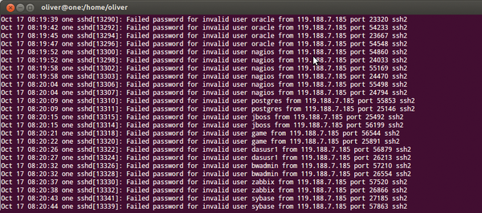
Brute Force – Find Username and Password
Use common usernames and passwords
Find out if user exists, try all passwords
Notes:
Lists of common passwords that have been compiled from data breaches and leaked account databases are available on the Internet.
One of them, a rather «small» one with 10 million passwords, can be found here:
https://xato.net/ten-million-passwords-faq-3b2752ed3b4c#.5m7a1kx2c
If brute force does not work or a more stealthy way of getting access to user account data is required, we have other options.
Image:
Log of a brute force attack on a secure login server offering a login using the secure shell protocol.
Optional: Discuss (imperfect) countermeasures providers could take
Allow only a certain number of login attempts per time frame and user (don’t block on a per user basis => an attacker might use this to let the service deny access to all users by triggering the blocking…)
Block computers that perform a brute force attack (blocking on a per IP address basis => this won’t block legitimate users)
Attackers might use botnets to run a brute force attack in a distributed fashion so that blocking measures are ineffective

Slide 10
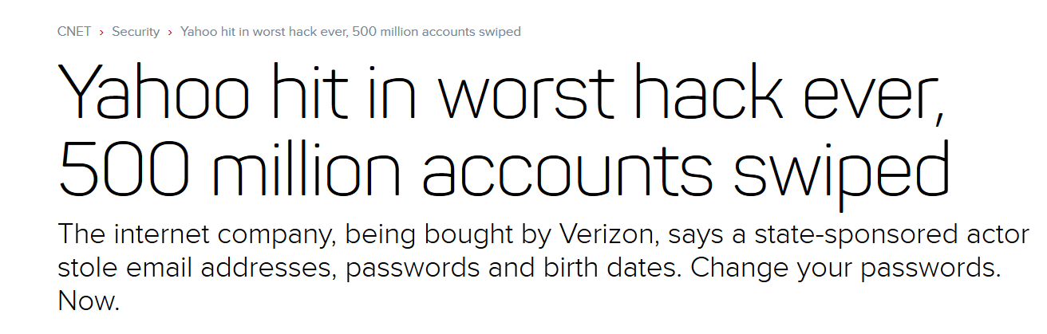
Exploit and Circumvent Protections
Many different ways how this could be done => not discussed now
Example of such a hack:
These passwords are not in plain-text!
Notes:
Yahoo Hack:
As of October 2016, we don’t know the full story and details behind the hack but it does seem that the attacker was not a very clever group of state-sponsored hackers as Yahoo did claim in their first press release about it. Most probably, Yahoo did not get the basics of securing the infrastructure right or made a (serious) mistake there. At least that’s what world-renowned security expert Bruce Schneier and others believe based on the information already published: https://www.schneier.com/blog/archives/2016/09/the_hacking_of_.html
It’s important to know that if you read that passwords have been leaked, this nowadays usually mean «encrypted» or more precisely, «hashed» passwords.
Let’s have a brief look at what hashed passwords are.

Slide 11

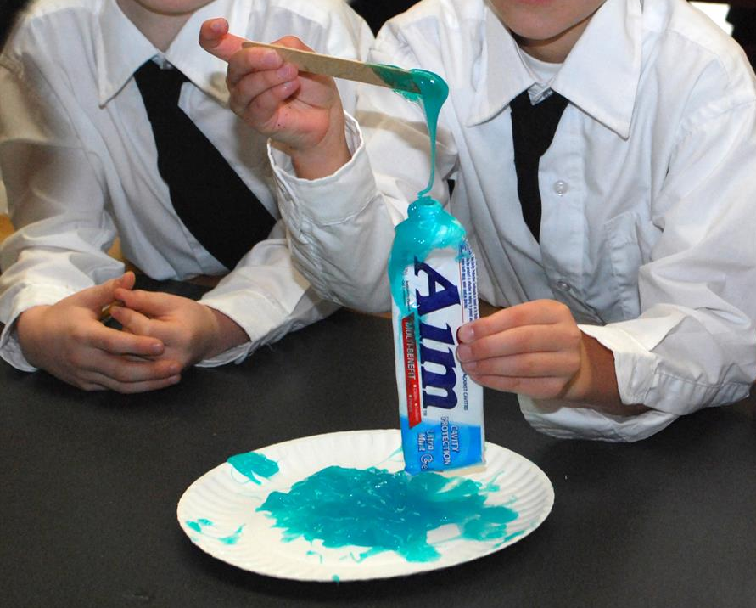

Hashed Passwords
A hash function is a one-way function
EASY
HARD
hash(strongpassword)=2AE868079D293E0A185C671C7BCDAC51DF36E385
hash⁻¹(2AE868079D293E0A185C671C7BCDAC51DF36E385) = ????
Hash generated using: http://passwordsgenerator.net/sha1-hash-generator/
Notes:
Demo 1 (Part I): You might demonstrate the hashing «live» using the following site to generate the hash from the password:
http://passwordsgenerator.net/sha1-hash-generator/
Note: The hash has been generated with the SHA-1 hashing method (unsalted). Hashing without salt is NOT considered best practice and SHA-1 is not considered to be a good choice anymore. But this approach allows for a «cracking» demo using crackstation.net later on and even best practice approaches using PBKDF2 are not secure against attacks brute forcing common passwords (several millions).
For more details on secure hashing using PBKDF2 see:
https://en.wikipedia.org/wiki/PBKDF2
Now that we know what hashed passwords are: What can a hacker do to still make use of the leaked password information?

Slide 12

Getting the Plaintext Passwords
Procedure:
List of common passwords
For each entry:
Check whether its hash matches the hash for which we want the plaintext password => password found
Password cracking as a service:
E.g., https://crackstation.net/
Next steps:
Users tend to re-use the same password at different sites
Try the password we just found at different sites!
Server-Side:
Can YOU do something to make such attacks more DIFFICULT?
Notes:
Demo 1 (Part 2): Here you can use crackstation.net to break the hash generated with the hash generator website on the previous slide.
At first glance, it seems that YOU as a user can’t do much to better protect the infrastructure from
brute force attacks and from
attacks that exploit vulnerabilities in the system or
from attacks that circumvent protections
But at a second glance, YOU CAN DO something to at least make such attacks more DIFFICULT to the attacker.
Let’s have a look at the following claim.

Slide 13
Discussion
Claim: Strong passwords make brute force attacks and exploiting stolen user account data more difficult.
Explain why strong passwords would help
Discuss in pairs for 2 minutes
Notes:
Form:
Let the students discuss the question in pairs for two minutes
Collect one or a few answers.
If you think the question is too difficult for the participants, you might give the following hint:
- Think of what a hacker needs to do in both cases
Answer:
In both cases, it is required that the hacker guesses the password and guessing a strong password is much more difficult (as per definition of strong password…) than of a simple password.
Now that we know we should select strong passwords, lets have a look at the following password.

Slide 14
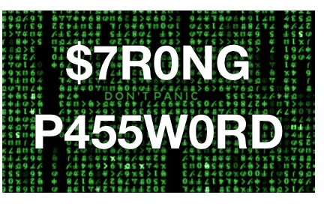

To the rescue: Strong Passwords?
Notes:
Discussion:
Is this a strong password?
If yes, why do you think it is a strong password?
If no, why do you think it is not a strong password
DO NOT YET TELL THE ANSWER!
Ok, let’s see. Bart Simpson selected this password for his school account….

Slide 15
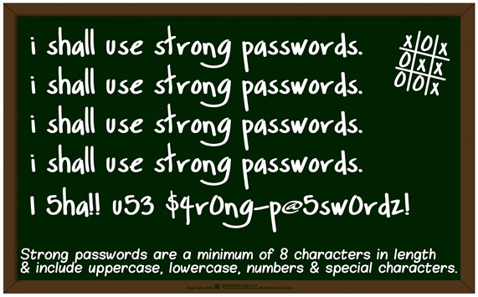
To the rescue: Strong Passwords!
10
Notes:
Oh, it appears that it was NOT a good enough password. Bart Simpson had detention because his account was broken into because of this.
While he seemed willing to learn and note down the rules for good passwords at the bottom, the last sentence shows that he might still miss an important point…
Let’s summarize the important points for strong passwords from the rules here and add some more things to consider.
Note: The original picture says 8 characters but this is no longer enough to be reistant to offline brute force attacks. It should be at least 10 or more characters.

Slide 16
Selecting Strong Passwords
Do you have to stick to these strict rules for all of your accounts?
Properties of a strong password:
At least 10 characters
Including small and capital letters, numbers and special characters
Add two characters if you don’t want numbers or special chars in your password.
Not a word which can be found in a dictionary or book
Use a different password for each of your accounts.
Notes:
How can you remember such strong but difficult passwords?
Optional discussion:
Sticking to these strict rules might not be necessary in some cases. Think of websites with no «value» where you don’t enter any relevant information like for example your birthday, hobbies etc.
Examples of such pages are pages where you want to download a report/document where you have to create an account with a valid email address to do so.
In these cases, it is anyway better to:
not to use your identity and
to make use of a temporary email address which you can get for free using services like www.throwawaymail.com/.
However, whenever damage/harm could be done when an attacker would have access to your account – this includes accounts for forum or chat-channel access where an attacker could publish problematic posts – you should stick to those rules.

Slide 17

Remembering Strong Passwords
Make up a sentence: «I get up in the morning and brush my teeth for three minutes."
Take the first letter of each word and make sure the resulting password is at least 12 characters long => Iguitmabmtftm
If numbers and special characters are required:
Replace "i" or «l" by 1
Replace "and" by & or "or" by "|"
=> Ms1a&pmmZ3M1
The sentence must be made up and should not be in any book or a famous sentence from a movie!

Slide 18
Handling Passwords

Slide 19
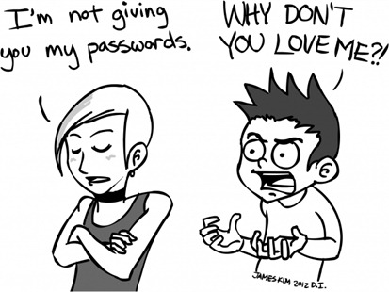
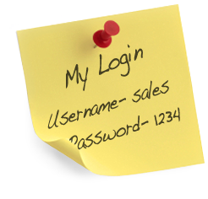
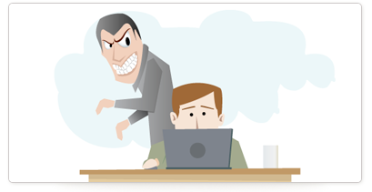
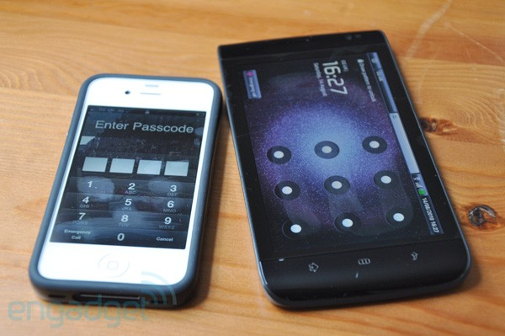
Handling Passwords
Notes:
Attackers are creative in finding ways to find out what your strong password is. Passwords have to be handled with care.
An attacker uses all opportunities to grab passwords like:
Passwords written down somewhere. Even if you think only people who anyway know the password can see it hanging there. You might be mistaken in this assumption as well show in an instant.
Trying to trick you into telling them your password. Don’t tell it to anyone – hackers are good at convincing you that they are someone you can trust…
Attackers like to do shoulder surfing you. If you suspect that someone has seen your password, change the password.
Attackers look for any trace that could help them find out your password. Don’t leave traces that might help someone to find out what’s your password. Question: Do you know what’s the password/code to unlock the two phones on the slide? A thief or your girlfriend or boyfriend might learn the code for your smartphone by simply looking at the traces of your fingers on the screen…
Optional: Discussion of security questions often used to recover passwords when someone forgets his/her password. They often use predefined questions about former pets, friends, preferred artists etc. This information might be easy to obtain considering that people publish a lot about their life and preferences in social media.

Slide 20
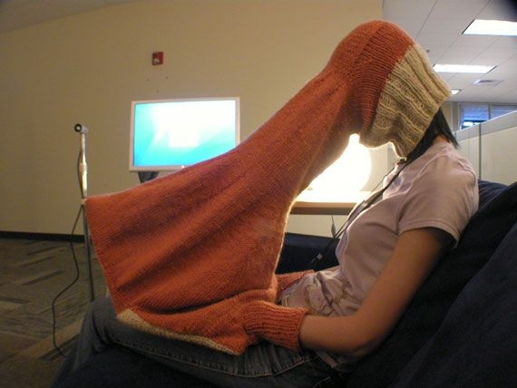
Shoulder-Surfing – Solution
Notes:
While it seems that this person here had a creative solution for the shoulder surfing problem, I don’t think this is a solution that suits all of us…
The only solution here is be careful and vigilant when you enter password information.

Slide 21
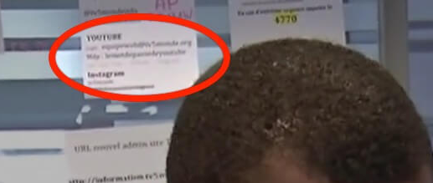
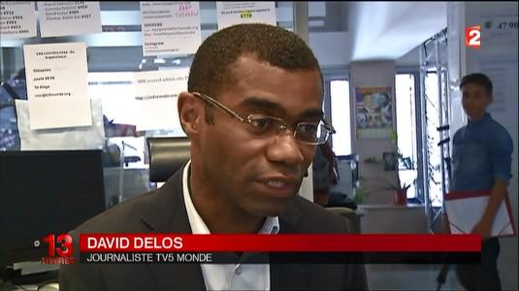
Can You Spot the Problem?
Notes:
A sad example why writing up passwords is not a good idea is the story around a report from TV5Monde about a satellite hack.
Question: Can you spot the problem?
Hence, even if you think the passwords are on display in a place where only people have access who anyway know the password, you might be mistaken.
More details about this story:
In an interview about the satellite hack with French news program 13 Heures, TV5Monde reporter David Delos unwittingly revealed at least one password for the station's social media presence. That's because he was filmed in front of a staffer's desk—which was smothered in sticky notes and taped index cards that were covered in account usernames and passwords.
Delos' segment revealed the usernames and passwords for TV5Monde's Twitter and Instagram accounts, but they were too difficult to read in an archived video of the broadcast. That wasn't the case for the YouTube information, however; Twitter user pent0thal confirmed that account's displayed password was "lemotdepassedeyoutube," which translates in English to "the password of YouTube."
A cursory glance at TV5Monde's social media accounts did not reveal any seemingly false or disruptive posts since the passwords were displayed on that French broadcast. However, the same Twitter user found another screengrab of a completely different news segment about TV5Monde's hacking ordeal—which also contained a post-it note with what appeared to be a staffer's general-use username and password.

Slide 22
Hijacking User Accounts
Phishing / Social Engineering

Slide 23
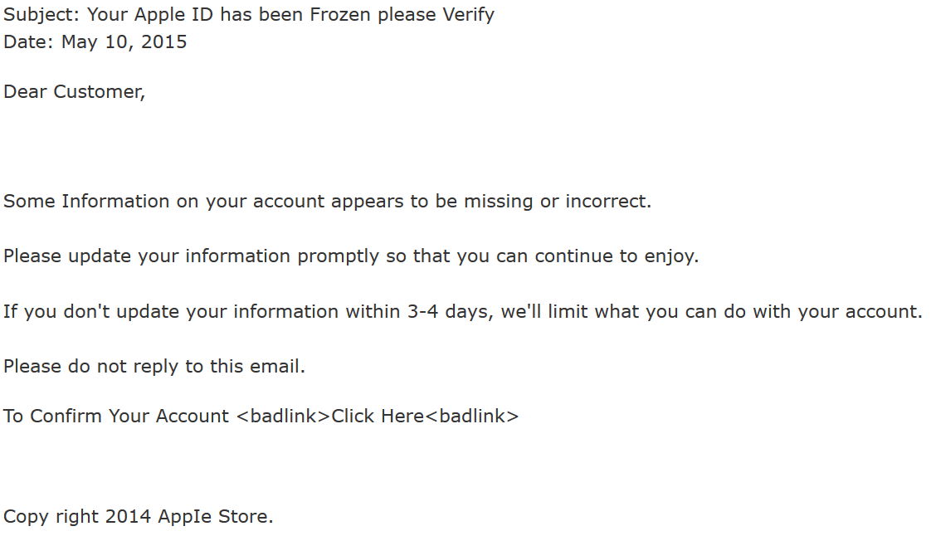
An E-Mail from Apple
From: apple@support.com
click here
What do you think about this e-mail and why?
Did you get similar e-mails in the past?
Notes:
The discussion of the questions usually results in that the participants find different clues that this e-mail is likely a fake:
The «From» address is not an email address from Apple
Typos in the mail:
Copy right instead of copyright
Apple store is written with an I instead of an L
Strange sentence: «… that you can continue to enjoy» => enjoy what?
Subject with inconsistent use of Capital letters
Apple would know the name of the customer
…
Well, it seems that we have identified quite a lot of clues that this e-mail is likely a fake.
More precisely, it’s a so-called phishing e-mail.
A classic e-mail phishing attack to steal account data works as follows.

Slide 24
Classic E-Mail Phishing Attack
(1) sends phishing e-mail
(4) username, password
Attacker
real web site
Victim
(2) username, password
(3) thanks, bye
fake website
Notes:
We assume the attacker uses a fake web site that looks the same as the website that is faked (at least login-screen).
Victims are lured to the fake web site via a phishing e-mail.
Victims provide the credentials and the attacker can use them at the real website.
Phishing in general is the attempt to obtain sensitive information such as usernames, passwords (and sometimes, indirectly, money), often for malicious reasons, by masquerading as a trustworthy entity in an electronic communication.
The previous example of a phishing e-mail was quite poorly written.

Slide 25
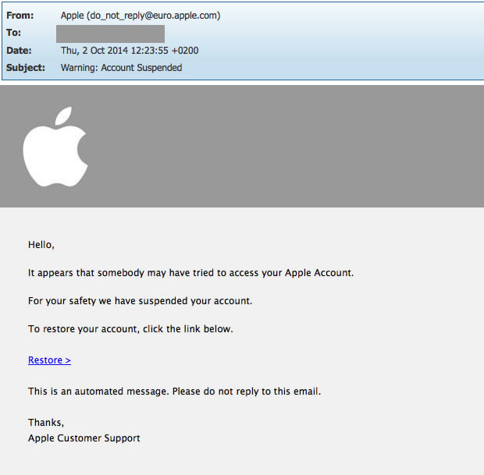
Another Example
Looks like a real Apple e-mail address! => Must be from Apple, right?
Notes:
Question: Why is this e-mail better than the one before?
Sender e-mail address is an address from Apple
Access warnings like this one are indeed sent by some service providers => send something that seems legitimate
Nevertheless, the user should not click on the link in this email, it’s a phishing e-mail.
Let’s now have a look at how difficult (or how easy) it is to craft such a phishing e-mail.
When doing this, let’s also have a look at additional clues (aside from the quality) that we can use to identify such e-mails.
Optional Question:
What would likely happen when the user replies to this email anyway?
Since the «From» address is not owned by the attacker, he would not be aware of the response.
Most likely, the attacker chose an address that does not exist or one that has an auto-reply sent telling the user that this is an address which is not managed by a human (e.g., “do-not-reply” address from newsletters).

Slide 26
Writing Phishing E-Mails is Easy…
Demo & discussion
Notes:
Demo 2 – Use https://emkei.cz/ to create your own story and e-mail. The following (hidden) slides show you the steps to perform with a teacher & homework sample.
Instead of doing it live, you might use the sample slides for the «Demo» and analysis.
WARNING: The e-mail and e-mail client software used in the following example are in GERMAN.

Slide 27
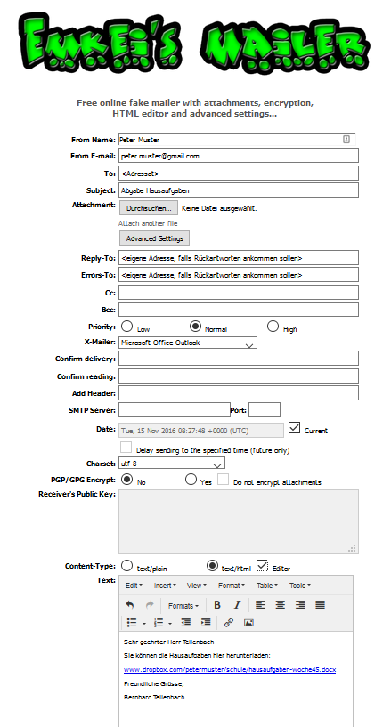
Creating and Sending a Phishing Mail
Complicated?
Programming skills needed?
Hacking skills needed?
=> NO!
Notes:
No programming or hacking skills needed. The Internet offers this service for free!
The screenshot shows an example of such a site that makes sending phishing e-mails easy and free:
https://emkei.cz/

Slide 28
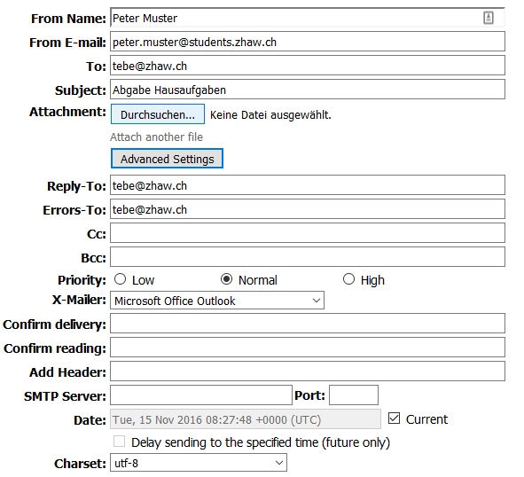
Creating and Sending a Phishing Mail (1)
Name and address of the sender as it should appear in the victim’s e-mail client.
Address to be used by the e-mail client when the victim clicks on “reply”.
Choose the e-mail program that the sender would have used.
Notes:
NOTE: You should prepare your OWN e-mail that matches YOUR setup and setting. This one is for a person that wants a teacher at ZHAW to download and open a malicious MS Word file. The person claims to be a student of this teacher and the link in the mail seems to point to the dropbox account of the student. Actually, it points to a “malicious site” hosting a malicious MS Word file.
First, we define the name and address of the sender as it should appear in the victim’s e-mail client.
The name and from address can be (almost) arbitrary.
Additional information:
We say almost because most mail providers (like Gmail) might block e-mails if the sending mail server is not listed as being responsible for sending e-mails for the domain in the from address of the e-mail.
So if a server in the emkei.cz domain sends an e-mail with a from address from Apple, this COULD be detected and blocked. But it’s not so easy because who knows what domains this server is actually responsible for?
For this approach to work, the domain owners have to setup and maintain so called SPF and DMARC records stating what mail servers are allowed to send mails for a specific domain. If a domain does not define this, it’s not possible to decide whether the sending mail server is allowed to send mails for this domain.
Another challenge with using SPF is mail forwarding where the sender’s address is preserved (most mail providers allow this). Suddenly, Gmail appears to send e-mails from arbitrary domains!
For systems making use of SPF not to block such e-mails, “forwarders” have to be whitelisted (or blocking based on SPF has to be turned off).
More details on faking the sender address and SPF and DMARC can be found here:
http://lifehacker.com/how-spammers-spoof-your-email-address-and-how-to-prote-1579478914

Slide 29
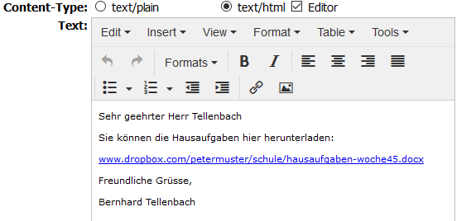
Creating and Sending a Phishing Mail (2)
Notes:
Next, we compile the actual message using the text/html WYSIWYG editor.
Note: COPY-PASTE the following text into the above window (or use a tool like LastPass to auto-fill/pre-fill the web form).
Replace this text with your OWN text (see previous slide):
Sehr geehrter Herr Tellenbach
Sie können die Hausaufgaben hier herunterladen:
www.dropbox.com/petermuster/schule/hausaufgaben-woche45.docx
Freundliche Grüsse,
Peter Muster

Slide 30
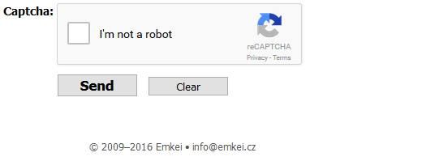
Creating and Sending a Phishing Mail (3)
Notes:
Finally, we send the phishing e-mail. We have to solve a CAPTCHA so that this site can not be misused to send large amounts of spam and or phishing e-mails by mass mailing tools.

Slide 31
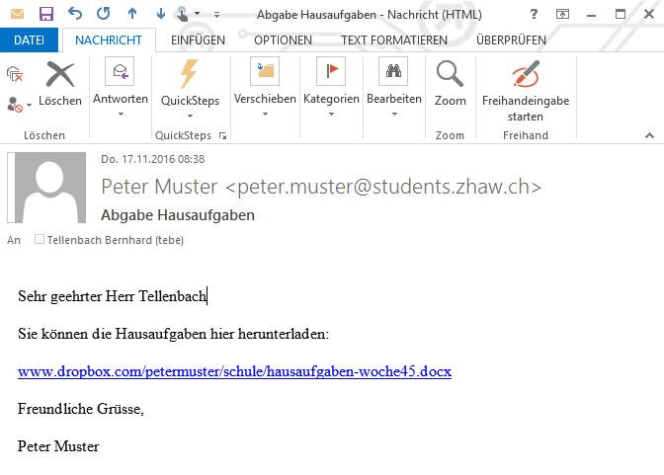
Recognizing Phishing E-Mails
Notes:
After sending the e-mail, we check our inbox and see that we received the phishing e-mail.
Let’s have a closer look at this e-mail.
How can we find out whether or not this e-mail is from Peter Muster?
If you have a Peter Muster in your class and if you ask them to hand in Homework this way: Would you be suspicious if you would get such an e-mail?
Collect ideas/opinions from participants. Do NOT comment them. Depending on what they already know about this topic, they might propose: - to check whether the link is actually leading to dropbox and a legitimate file - to scan the file for viruses first, e.g. using the https://www.virustotal.com/ online scanner. - to reply to the email and/or to write an e-mail to Peter Muster to ask him whether this is indeed his homework e-mail (this makes not a lot of sense though if you expected to get this homework email)
Ok, now let’s see what I would do to find out whether or not this e-mail is indeed an e-mail from Peter Muster.

Slide 32
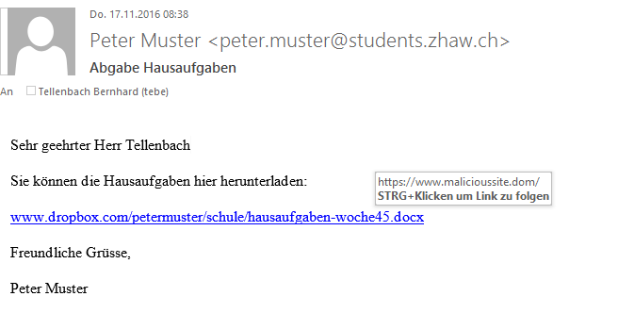
Recognizing Phishing E-Mails (1)
Hover your mouse over the link. You should see the address to which this link leads you.
Notes:
Today, all modern e-mail clients offer the future to hover your mouse over a link to see what is the address to which you would go when you click on it.
But how can the page listed in the e-mail and the page we get to when we click on it be different?

Slide 33
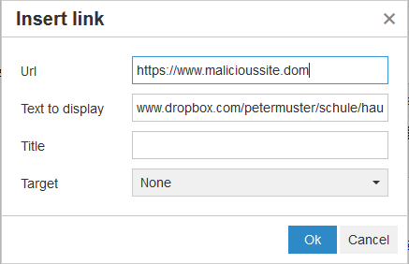
Recognizing Phishing E-Mails (2)
Notes:
If we check the text that we entered, we see that we selected text/html. HTML is a text description language in which also webpages are written. Hence, we can create arbitrary looking e-mails with this. And as you might know from surfing the web, a link on a web page does not necessarily have to list the address to which it leads to. You often find links with arbitrary text like e.g., “Read more…” or “Click here”.
If we insert a link using the editor and the link symbol, we can see that we can enter the address to which the links should get you and a text how the link should be displayed. These do not have to be the same!
Hence, be careful and make sure that a link in the e-mail gets you to the page you think it should get you.

Slide 34
Recognizing Phishing E-Mails (3)
Did Peter Muster send this?
How could we check this?

Slide 35
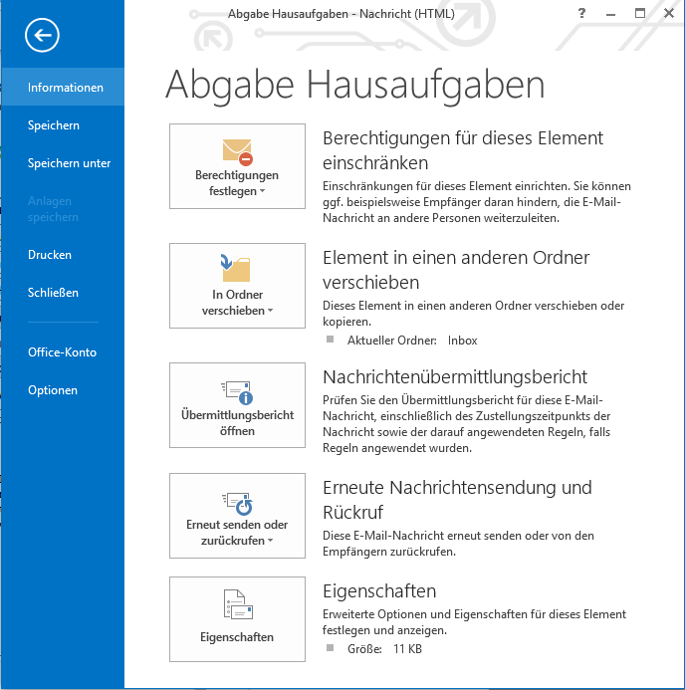
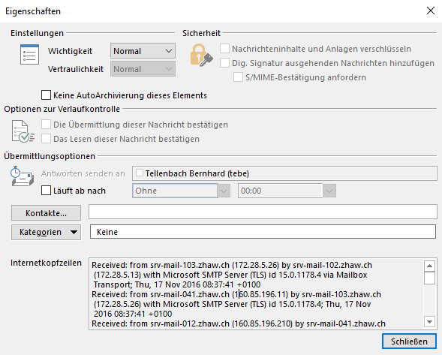
Recognizing Phishing E-Mails (4)
1
2
3
E-mail header – Includes information about the path the e-mail took to reach you
Notes:
For the e-mail client of your choice, show how the e-mail header can be displayed by this e-mail client.
The e-mail header contains information about the path the e-mail took to reach you.

Slide 36
Recognizing Phishing E-Mails (5)
Received: from srv-mail-103.zhaw.ch (172.28.5.26) by srv-mail-102.zhaw.ch […]
Received: from srv-mail-041.zhaw.ch (160.85.196.11) by srv-mail-103.zhaw.ch […]
Received: from srv-mail-012.zhaw.ch (160.85.196.210) by srv-mail-041.zhaw.ch […]
Received: from srv-mail-012.zhaw.ch (localhost [127.0.0.1])
by localhost (Postfix) with SMTP id 6435F412
for <tebe@zhaw.ch>; Thu, 17 Nov 2016 08:37:41 +0100 (CET)
Received: from emkei.cz (emkei.cz [46.167.245.116])
by srv-mail-012.zhaw.ch (Postfix) with ESMTP id 3D91F1E6
for <tebe@zhaw.ch>; Thu, 17 Nov 2016 08:37:41 +0100 (CET)
Received: by emkei.cz (Postfix, from userid 33)
id 1F5A0D5F45; Thu, 17 Nov 2016 08:37:38 +0100 (CET)
To: <tebe@zhaw.ch>
Subject: Abgabe Hausaufgaben
From: Peter Muster <peter.muster@students.zhaw.ch>
X-Mailer: Microsoft Office Outlook
…
Notes:
Question:
What’s wrong with this information? Which path did the e-mail take?
Answer:
The first “received” is the server from your domain from which you get your e-mails. Here, the ZHAW domain. In this example, the ZHAW domain seems to have multiple servers. Probably an incoming server connecting to the Internet and then internal servers reflecting the organizational structure.
The last “received” is the server that was used by the sender to send the e-mail to the recipient. If the name of the server is not in the domain listed in the from address (here zhaw.ch), this is very suspicious and it is likely that this is a spoofed from address!

Slide 37
Summary – Phishing E-Mails
The quality of phishing e-mails is usually quite bad
This might be on purpose
If someone does not realize this, the rest of the attack is more likely to succeed (=> filter)
If the quality is good but you are in doubt:
Check embedded links without clicking on them (hover)
Do they point to where they want you to believe they point to?
Check the «from» e-mail address:
Do content and the address match?
Ask the sender whether this is legitimate using an official point of contact
Check the e-mail header – does the sending server’s domain match the domain in the e-mail address?
Google the subject/email address – is this a known phishing campaign?
Notes:
Unfortunately, e-mail is not the only attack vector to steal user account data. There are other phishing channels!

Slide 38
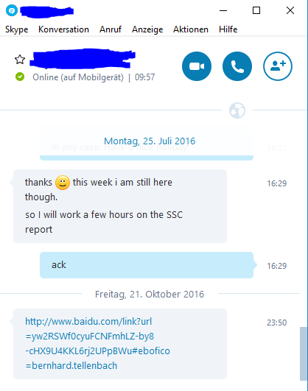
Phishing in General
Phishing is not limited to e-mail
Messengers like WhatsApp or Skype
Social media (Facebook, twitter,…)
Phone calls
…
What happened here? Would you click on that link?
Faking the sender does not work for most of them. But you can steal user account data of legitimate users!
Notes:
The screenshot shows a real phishing case where the skype account of a colleague of the author of the slides got hacked. The hacker used the account to send links pointing to malicious sites to all persons in the contact list of the colleague’s skype account.
Depending on the time, you might ask and discuss the question on the slide with the audience or give the answer yourself.
Important take away:
Be critical and use your brain when a colleague behaves “strangely”. In this case, a link pointing to a Chinese site with the name of the author of these slides the link is strange. As is the time the link was sent.
In this unit, we had a closer look at phishing but phishing is just one example of an attack from the social engineering class of attacks.

Slide 39
Social Engineering
Non-technical attack vector
Psychological manipulation of people into performing actions or divulging confidential information
A type of confidence trick for the purpose of information gathering, fraud, or system access
It is often one of many steps in a more complex fraud scheme
Notes:
For example, someone might trick you into letting him/her enter a building.
But let’s now have a look at one final example of phishing that makes use of our trust in technology…

Slide 40
Phishing – One Final Example
Demo and discussion
Notes:
Phishing using the «trusted» SMS technology….
Ask the for two volunteers from the audience. They should have each others mobile phone number in their contact list on the phone.
Perform the attack and send one of the volunteers an SMS with the other volunteer’s phone number as sender As content, you could e.g.
send a recommendation and a link to a malicious app that the volunteer should install
ask the recipient to visit a website and to do something there
to be at a specific place at a specific time (fake meeting)
use it for mobbing while hiding your true identitiy
Let them explain to the audience what they see on their phone.
Let the person that got the SMS click on the link at tell the audience again what he/she sees.
Discuss with the audience whether they think this works better than e-mail phishing or not.
- Pro: More «trust» in the media «SMS». It is little known that spoofing is possible and a message in the communication stream of a colleague seems far less suspicious than an «isolated» e-mail message.
You might consider showing them how you did it. This is up to you.

Slide 41
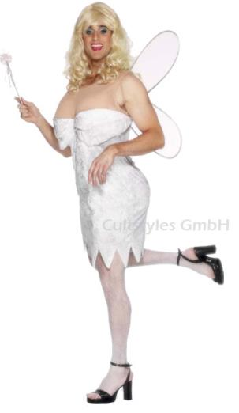
First Line of Defence – Use Your Common Sense!
Do I really have relatives in Nigeria?
Did I really win in the lottery?
Would company X really ask for my user account data by e-mail?
…
Notes:
These tips apply to all kinds of phishing! Use your brains. If something smells fishy, check and verify!

Slide 42


Second Line of Defence: Trust but verify!
Notes:
If something smells fishy, check and verify!
Get in touch with the sender of the message, ideally using a different channel
Ask Google whether there is currently a phishing/social engineering campaign ongoing on the media over which you got the message (e.g., WhatsApp, e-Mail, Phone,…). Use keywords from the subject or content of the message.

Slide 43
Hijacking User Accounts
Malware

Slide 44



Using Malware to Hijack User Accounts
Mail
Notes:
Another way to steal user account (and other) data from a victim is to infect its computer with malware.
The slide shows the steps involved.
If you did the demo with the phishing e-mail with a link to a malicious word document, you can make the link to this demo and now open the word document.
The Word document should look legitimate and make the victim click on an embedded «excel» sheet which is actually not (only) an excel sheet.
By clicking on the content, an executable is started which has the name excel.exe so that the victim does not get suspicious when MS Word asks the victim whether it really wants to open excel.exe.
But since this is not the real excel.exe but an embedded executable, this executable could do anything on the victims machine! To keep up the facade, the executable starts excel and displays data so that the vicitm does not get suspicious.
If you remove the «overlays» in the MS Word document that make the embedded executable look like an embedded excel sheet, you can de-mask this «social engineering» attempt.
This is an example of how difficult it can be to detect malicious content and how clever hackers can be – they do out-of-the-box thinking to confront you with the unexpected!
Countermeasures for this example:
Again: Use your brain and check on what you click.
Remember that office documents can contain malware and if your anti-virus program does not detect it (which is quite likely) and you run it, you’ve been hacked
Don’t run anything that’s embedded in a word file. Ask the sender to send the content separately!

Slide 45
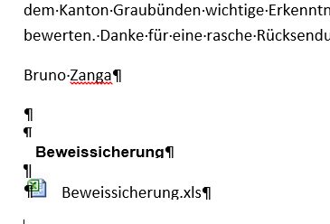
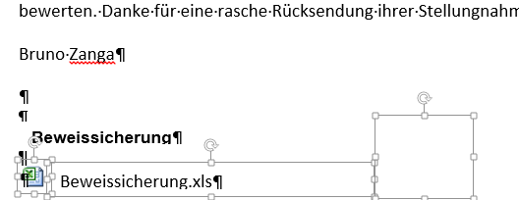

The Trick…
what’s behind the curtain…

Slide 46

Questions

